Slide 1

DEPARTMENT OF PHYSICS AND NANOTECHNOLOGY
SRM INSTITUTE OF SCIENCE AND TECHNOLOGY
18PYB101J Module-II Lecture-8

Slide 2
CONTINUITY EQUATION
In the previous sections, we have understood the following concepts.
Drift due to an electric field.
Diffusion due to a concentration gradient.
Recombination of carriers through intermediate-level recombination centers.
The contribution of the overall effect when drift, diffusion, and recombination occur simultaneously in a semiconductor material. The governing equation is called the continuity equation.
18PYB101J Module-II Lecture-8

Slide 3
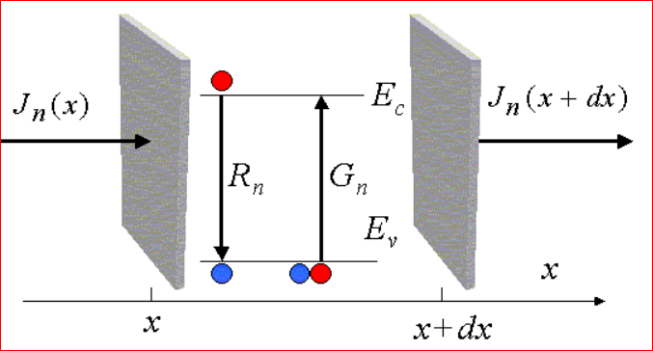
The continuity equation describes a basic concept, namely that a change in carrier density over time is due to the difference between the incoming and outgoing flux of carriers plus the generation and minus the recombination.
Electron currents and possible recombination and generation processes
The flow of carriers and recombination and generation rates are illustrated with Figure
18PYB101J Module-II Lecture-8

Slide 4

One-dimensional continuity equation for electrons
Consider an infinitesimal slice with thickness dx located at x. The number of electrons in the slice may increase due to the net current flow into the slice and the net carrier generation in the slice (mainly four components contribution). {Law of conservation of charges}
The number of electrons flowing into the slice at x, minus the number of electrons flowing out at x + dx, plus the rate at which electrons are generated, minus the rate at which they are recombined with holes in the slice.
The first two components are found by dividing the currents at each side of the slice by the charge of an electron.
The generation and recombination rates are designated by Gn and Rn , respectively.
The overall rate of change in the number of electrons in the slice is given as below
where A is the cross-sectional area and Adx is the volume of the slice where A is the cross-sectional area and Adx is the volume of the slice
4
18PYB101J Module-II Lecture-8
Notes:
Dear Fraternity: Please introduce the concept of relation between the current density, current like J=I/A , so that J.A=I etc….
JA(x)/q = I [in to element]
JA(x+dX)/q = I [out of the element]

Slide 5



Expanding the expression for the current at x + dx in Taylor series yields
We thus obtain the basic continuity equation for electrons:
A similar continuity equation can be derived for holes, except that the sign of the first term on the right-hand side of Eq is changed because of the positive charge associated with a hole.
Gn = e- generation rate
Rn = e- recombination rate
Gp = hole generation rate
Rp = hole recombination rate
18PYB101J Module-II Lecture-8

Slide 6
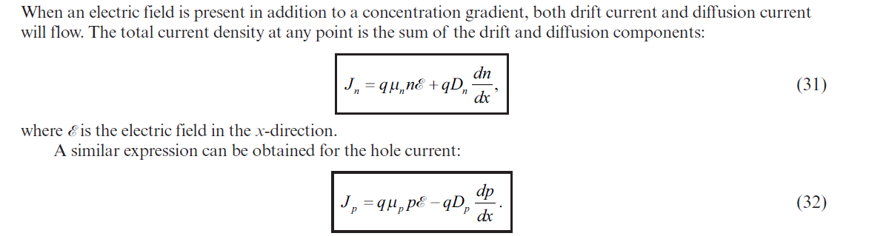
For the one-dimensional case under low-injection condition, small electric field, uniform doping etc.
The continuity equations for minority carriers :
(i.e., np in a p-type semiconductor or pn in an n-type semiconductor)
18PYB101J Module-II Lecture-8

Slide 7
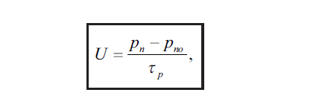
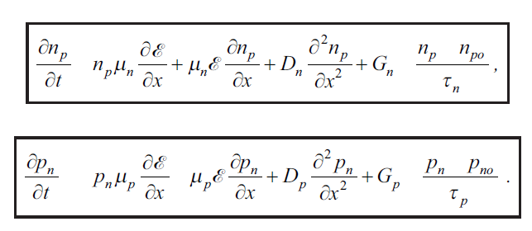
18PYB101J Module-II Lecture-8

